Slide 1
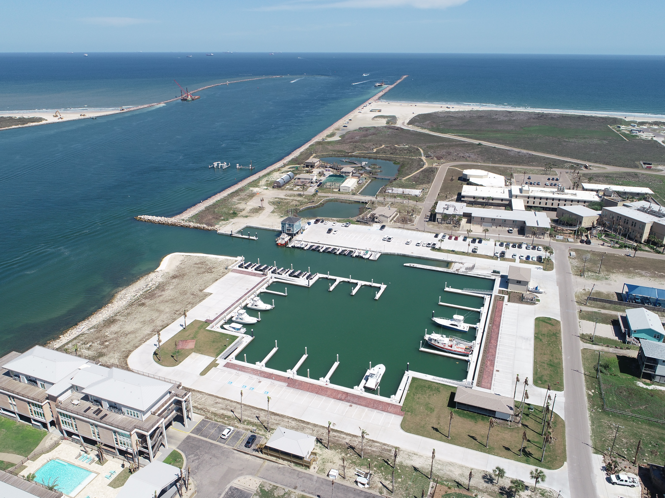
Boat Slip Rentals at UTMSI
The University of Texas Marine Science Institute has a private marina in Port Aransas, TX, offering yearly slip rentals to the public. Daily or monthly rentals are not available. No overnight stays permitted. Must meet insurance requirements. Rate: $12 per foot of boat length per month, including utilities, paid quarterly.
Boat Slips:
Slips available are 30’- 45’ and 45’- 60’
Available option if boat length is smaller than slip, charge will be the least length of slip/$12 per month. (ex: 24’ boat into a 30’ slip will be $12 X 30’ per month.
Make a reservation request using the instructions in the following pages.
Questions: call 361-749-6707 or email laurie.david@austin.utexas.edu

Slide 2
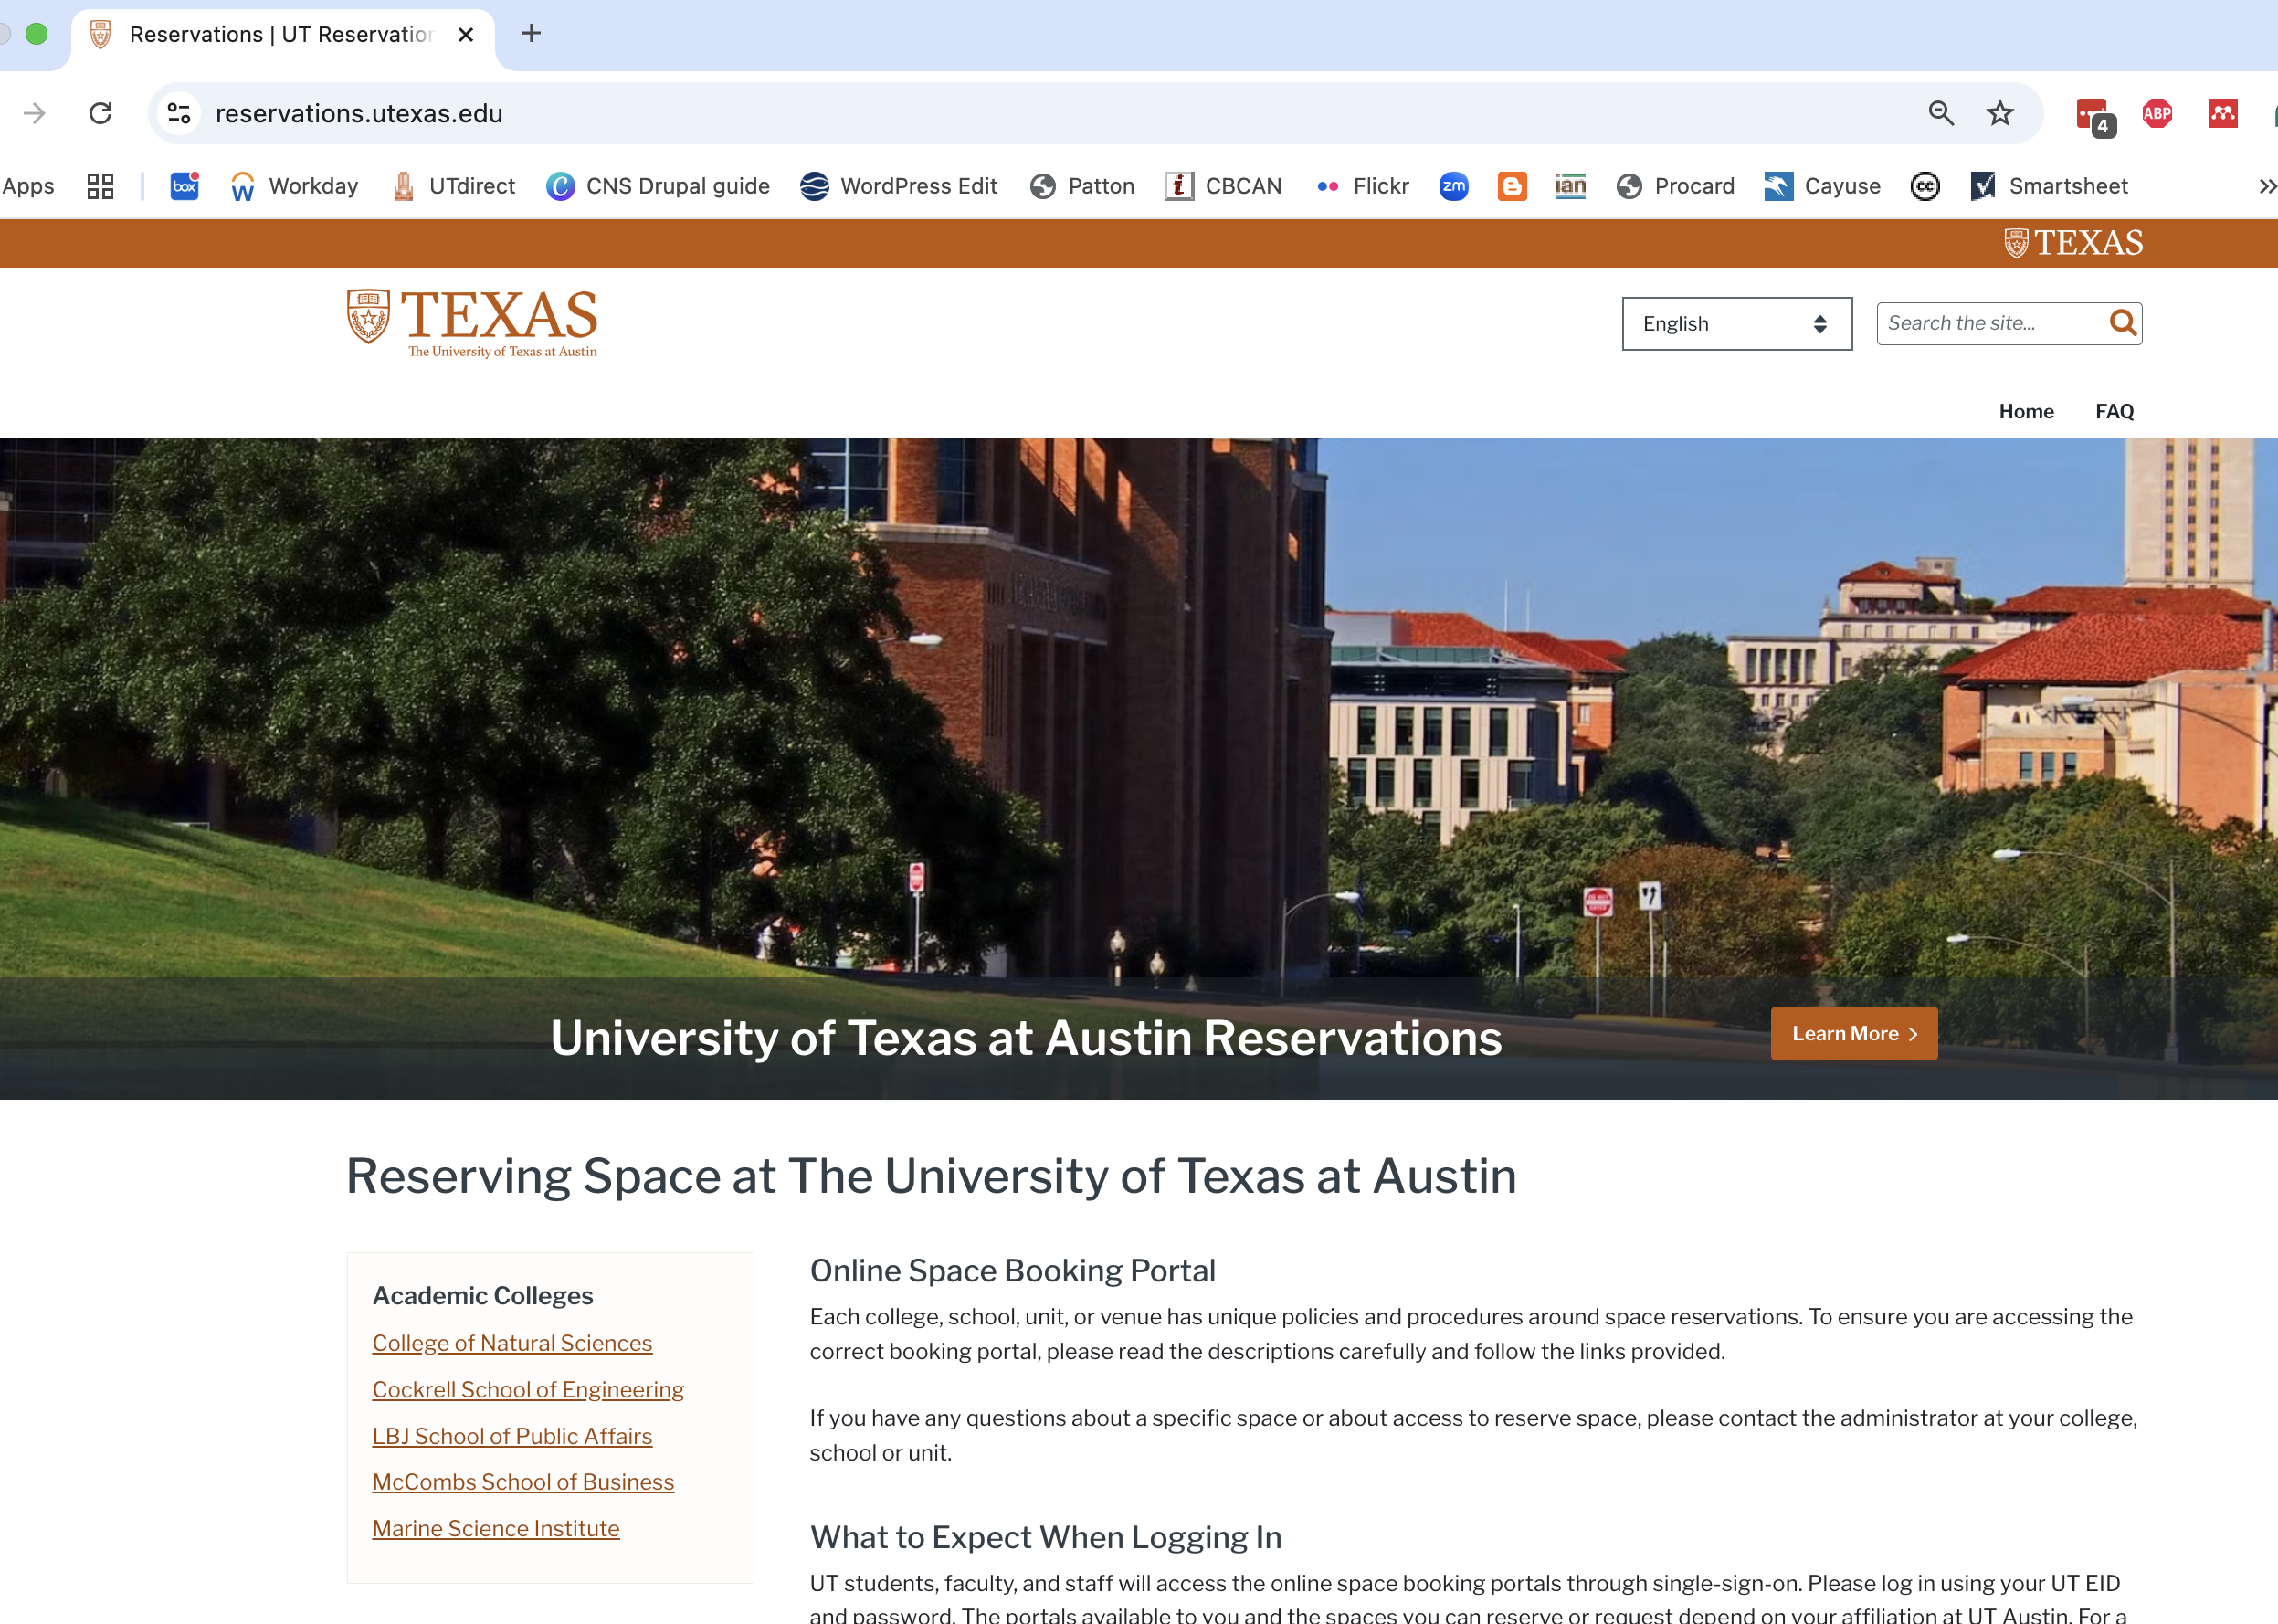
How to Make a Reservation
Go to Reservations | UT Reservations (utexas.edu) and click on Marine Science Institute
Scroll down to available space for general public

Slide 3
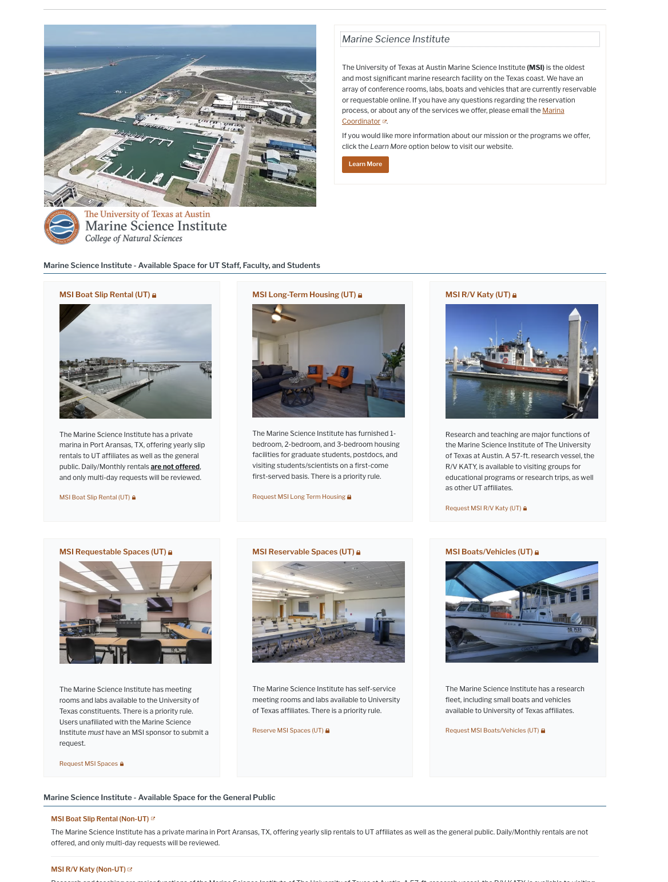
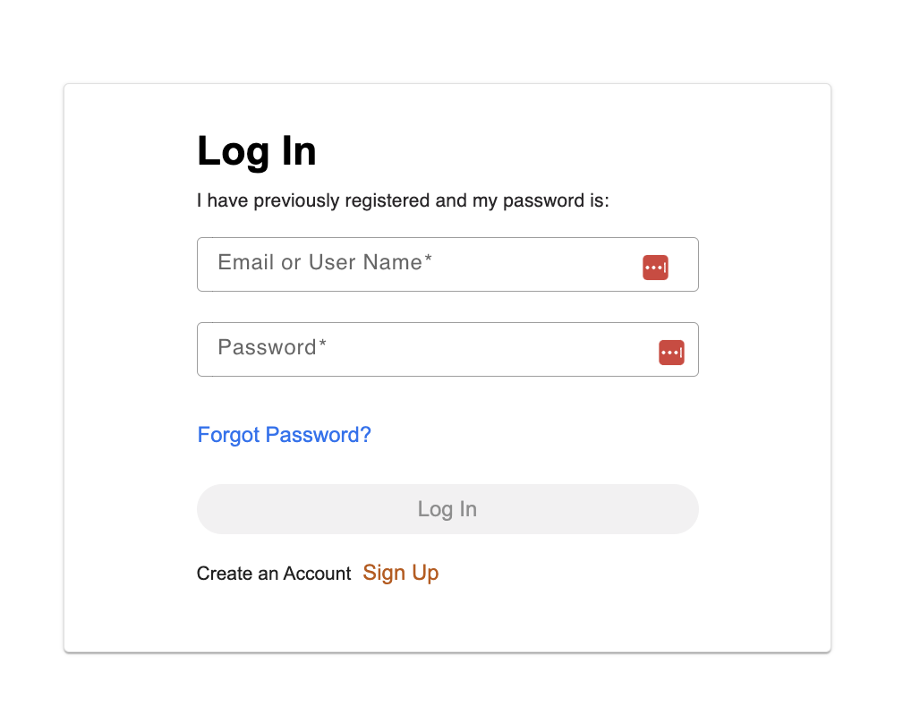
How to Make a Reservation
Scroll down to available space for general public.

Slide 4
How to Make a Reservation
You will be required to set up an account.

